Slide 1
CARR’S FLOWABILITY INDEX FOR BULK SOLIDS

Slide 2
CONTENTS
1
2
3
4
5
6
7
8
COMPRESSIBILITY INDEX
HAUSNER RATIO
ANGLE OF REPOSE
ANGLE OF SPATULA
COHESION INDEX
UNIFORMITY
ANGLE OF
FALL
DISPERSIBILITY

Slide 3

WHO
WAS
CARR?
Ralph L. Carr Jr. was a graduate of Northeastern University and he had published numerous amount of articles expressing an alternative method of evaluation the flow of dry powders. These are used to determine the flow characteristics of dry solids and these are today known as the “Carr Indices”.
Ralph L. Carr Jr. on the left along with his father and sister on the right

Slide 4
WHAT IS FLOWABILITY?
Carr referred to the overall measurement as the indication of the “Flowability” and “Floodability” of a dry powder.
The term “Flowability of Powder” is said to be the degree of easiness of the relative movement of the powder from stationary to a moving state.
A solid’s Floodability is its tendency to flood, or move in an unstable, liquid-like flow. The more floodable a solid is, the more likely it is to have an uncontrolled or undesired flow.

Slide 5
WHAT IS CARR FLOWABILITY INDEX?
The Carr Flowability Index is quantification of the flowability of bulk solid material. It is a combination of different tests to determine flow behaviour of the material. It comprises of the following:
Compressibility index
Angle of Repose
Angle of Spatula
Uniformity / Cohesion Index

Slide 6
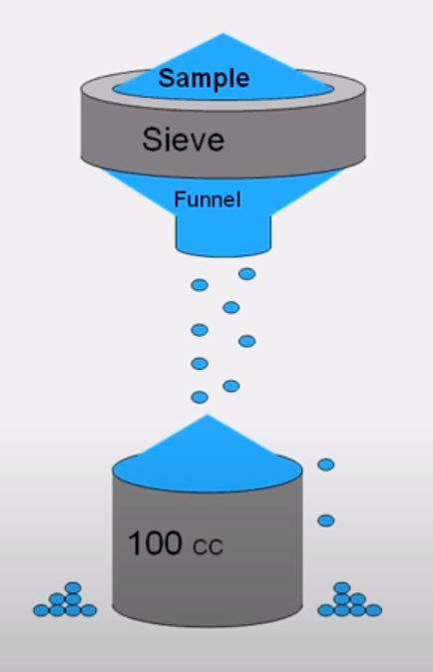
Aerated Bulk Density (ρ_{b0})
Mass per volume of loose powder, Carr used a 100 cc cup
A sieve with a mesh size greater than D100 is used to control the flow

Slide 7
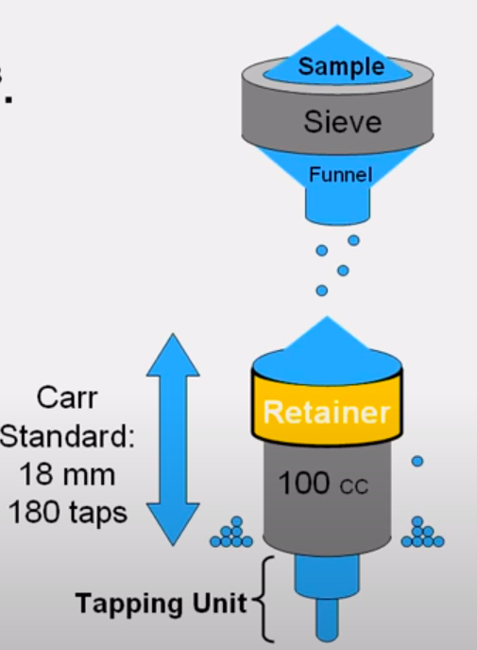
Tapped bulk density (ρ_{t})
Mass per volume of packed powder, 100 cc cup
Fill container while tapping unit raises and drops it continuously

Slide 8
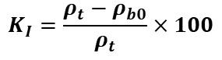
COMPRESSIBILITY INDEX
The ability of the powder to be compressed into a container. The formula to calculate the compressibility index of the given is:
Where,
ρ_{t} : the tapped bulk density of the material
ρ_{b0} : the loose bulk density of the material
$$K_{I}=\frac{ρ_{t}−ρ_{b0}}{ρ_{t}}×100$$
Lower the compressibility index, higher is the flowability

Slide 9
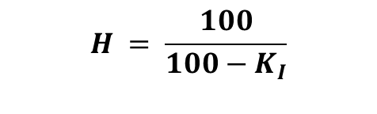
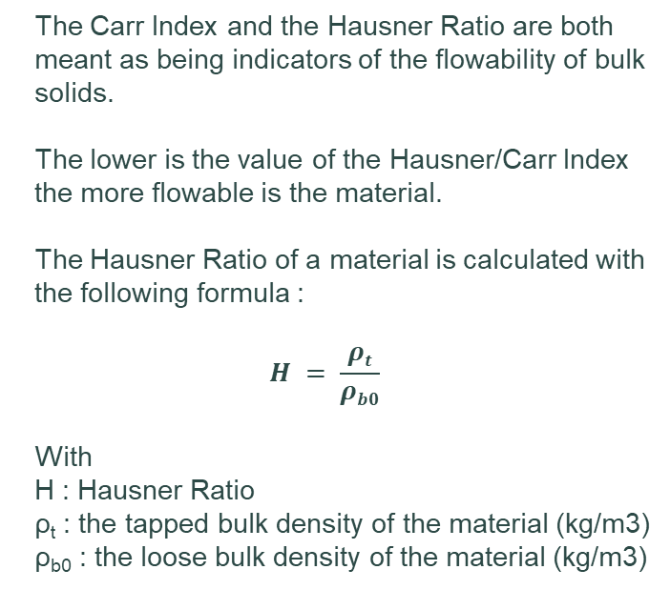
HAUSNER RATIO
It is possible to relate the Carr Index and the Hausner ratio with the following formula :
The Carr Index and the Hausner Ratio are both meant as being indicators of the flowability of bulk solids.
The lower is the value of the Hausner/Carr Index the more flowable is the material.
The Hausner Ratio of a material is calculated with the following formula :
$$H = \frac{ρt}{ρb0}$$
With
H : Hausner Ratio ρ_{t} : the tapped bulk density of the material (kg/m3) ρ_{b0} : the loose bulk density of the material (kg/m3)
$$H = \frac{100}{100−K_{I}}$$

Slide 10
ANGLE OF REPOSE
DRAINED
02
POURED
01
DYNAMIC
03
It is the steepest angle relative to the horizontal plane which a material can be piled without slumping or the surface material sliding
Drained Angle of Repose is the slope angle of the material remaining in a container with flat bottom and central outlet after discharge
It is a conical pile of loose, uncompacted bulk solid which is usually formed by pouring it through a funnel which is located at the bottom plate
This angle is measured in a slowly rotating cylinder with horizontal axis

Slide 11
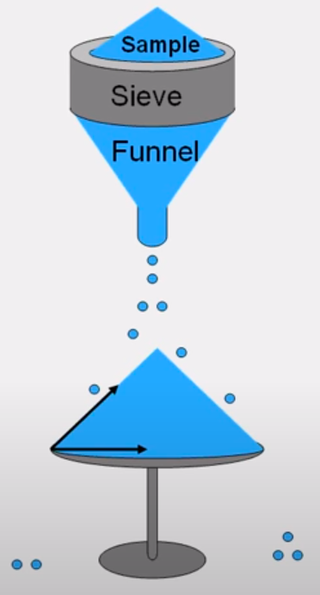
POURED ANGLE OF REPOSE
Angle of repose is the angle the slope of a heap of loose uncompacted material makes with the base. The funnel can either be fixed or moved upwards while the pile is formed to keep the distance between the tip of the funnel and the pile constant.
The angle is calculated by taking tan⁻¹ of the ratio of height of heap to radius at the base

Slide 12
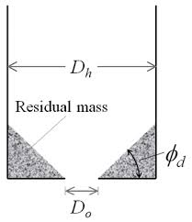
DRAINED ANGLE OF REPOSE
Drained angle of repose is the slope angle of the material remaining in a container with flat bottom and central outlet after discharge.

Slide 13
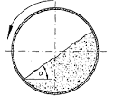
DYNAMIC ANGLE OF REPOSE
This angle is measured in a slowly rotating cylinder with horizontal axis.
Depending on the revolving speed and the bulk solid properties one obtain constant lateral free surface slope, especially with cohesive materials it can be observed that the bulk solids do not flow down continuously

Slide 14
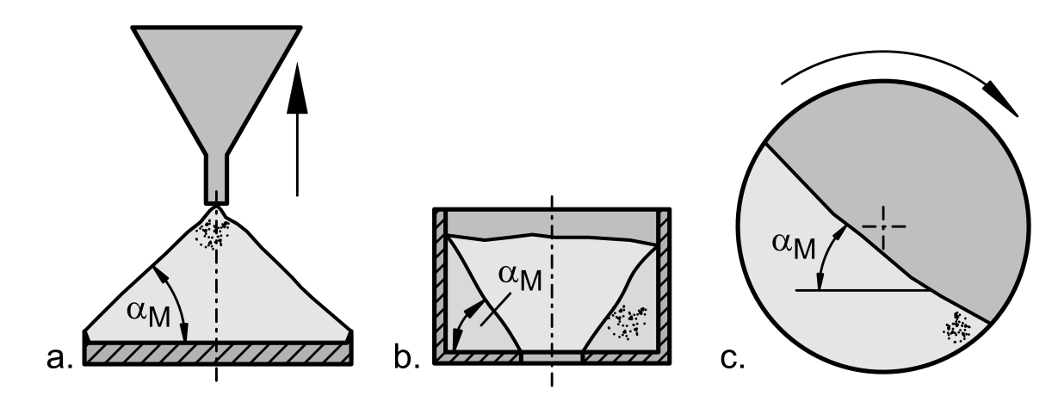
COMPARISON
a. Poured angle of repose
b. Drained angle of repose
c. Dynamic angle of repose
Lower the angle of repose, higher is the flowability

Slide 15
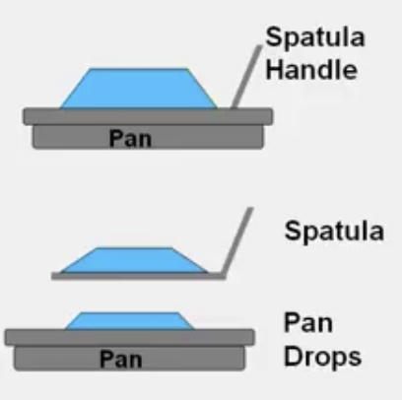
ANGLE OF SPATULA
This measurement provides additional information about the powder “flowability” similar to the Carr Angle Repose.
The angle b/w the horizontal and slope of a heap of powder is measured.
Impact is applied to the spatula that deforms the initial angle which is then measured again.
The average of both angles is identified to be the Carr Angle of Spatula
Lower the angle of spatula, higher is the flowability

Slide 16
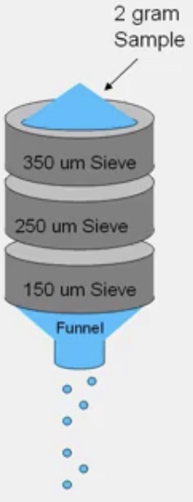
COHESION INDEX
The measurement of cohesive forces on surfaces of fine particles:
Electrostatic Charge
Smaller Particles can cohere to larger particles or form agglomerates
A sieve with a mesh size greater than D100 of sample is used to control the flow of the material under observation.
Vibration Amplitude = 1mm is induced by the stack of sieves.
The screens are then weighed to measure how much of sample stays back due to natural cohesion .
The more is the cohesiveness the less is the flowability.
for MBD <0.4 g/cc

Slide 17
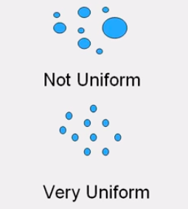
UNIFORMITY
The Carr Uniformity method identifies size similarity of powder particles using sieve analysis. As the definition suggests the particles in this case are uniform and identical in size and shape.
Uniformity = D60/D10
Where,
D60 = Diameter at which 60% pf the particles are less than
D10 = Diameter at which 10% of particles are less than
The more is the uniformity, the more is the flowability.

Slide 18
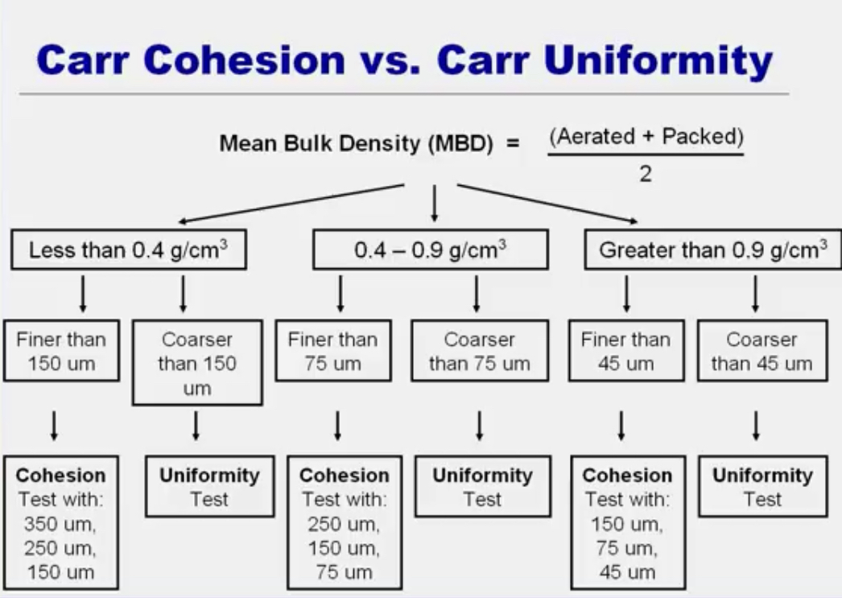

Slide 19
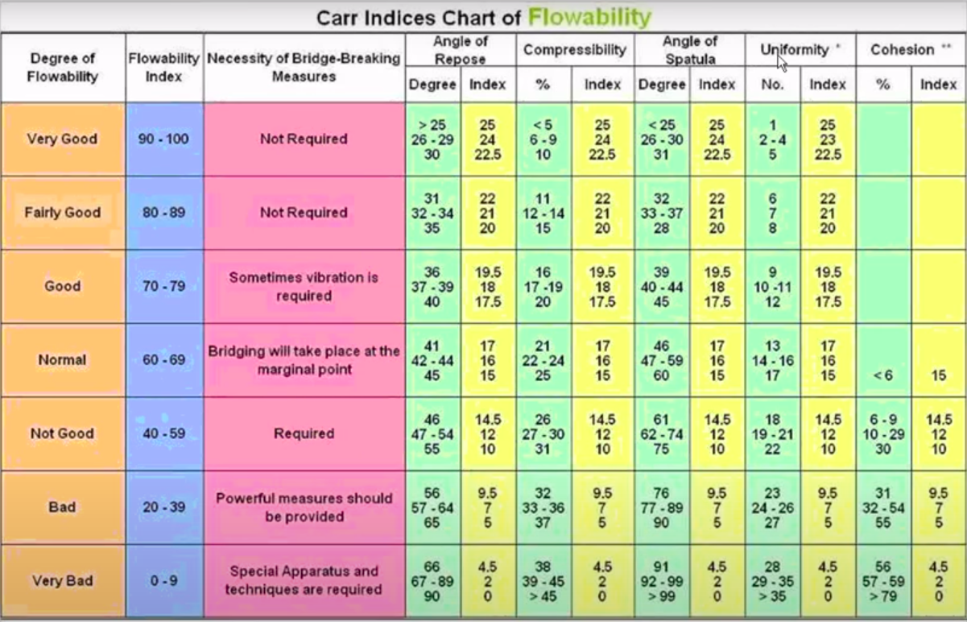

Slide 20
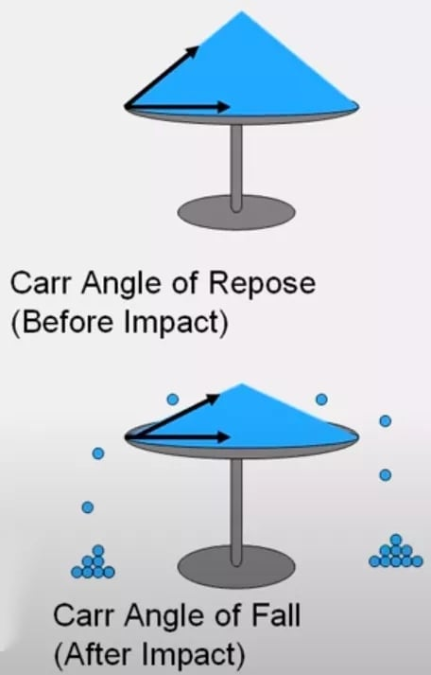
ANGLE OF FALL
The Carr Angle of Fall is determined after the Angle of Repose heap of material is jarred or distrubed resulting in reconfiguration of initial heap
Angle of Difference is the difference of Angle of Repose and Angle of fall
Lower the angle of fall, higher is the floodability

Slide 21
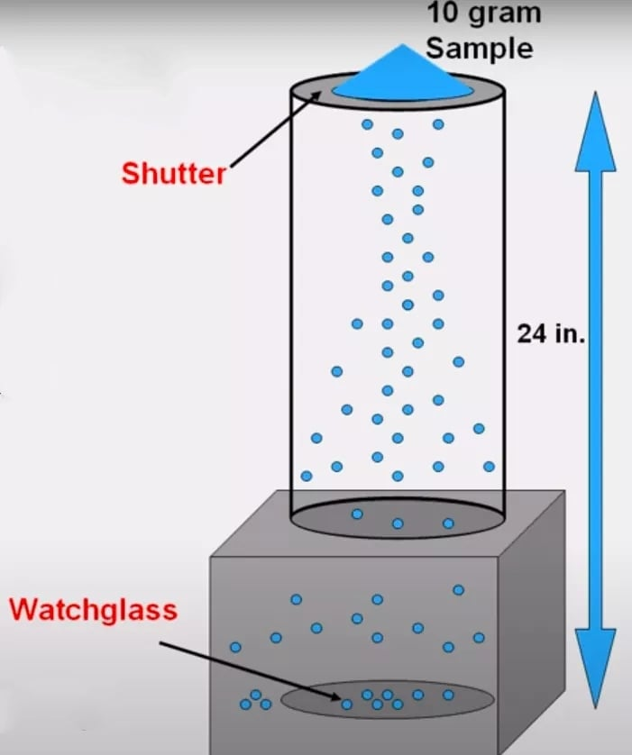
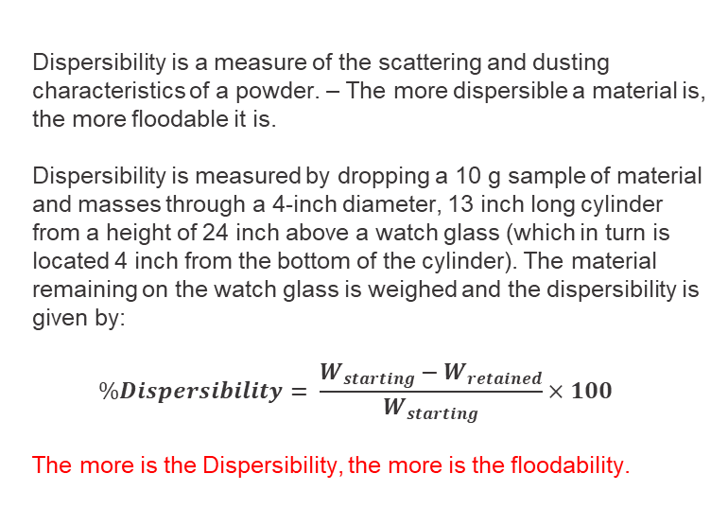
DISPERSIBILITY
Dispersibility is a measure of the scattering and dusting characteristics of a powder. – The more dispersible a material is, the more floodable it is.
Dispersibility is measured by dropping a 10 g sample of material and masses through a 4-inch diameter, 13 inch long cylinder from a height of 24 inch above a watch glass (which in turn is located 4 inch from the bottom of the cylinder). The material remaining on the watch glass is weighed and the dispersibility is given by:
$$\%Dispersibility= \frac{W_{starting}−W_{retained}}{W_{starting}}×100$$
The more is the Dispersibility, the more is the floodability.

Slide 22
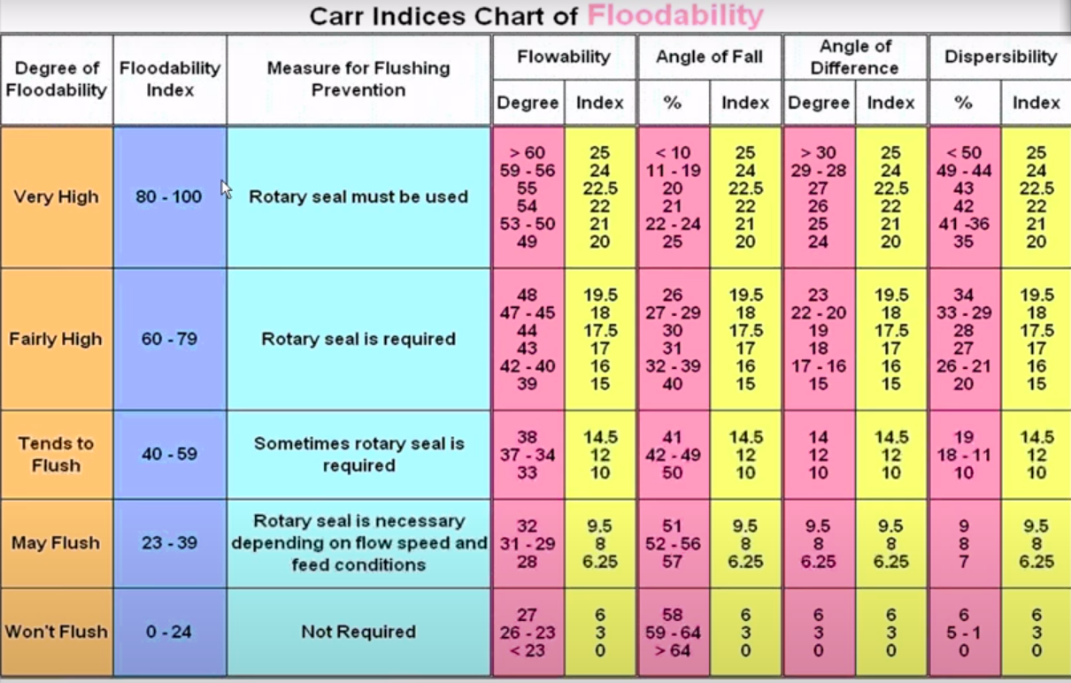

Slide 23
Thank you!

